Slide 1
INTRO TO DEVOPS
By: Ahmed Elbendary

Slide 2
WHAT WE’LL COVER ▸What is DevOps? ▸What problems does DevOps address? ▸How does DevOps relate to Agile? ▸What can DevOps do for you?

Slide 3
THE PROBLEM WE FACE
Everything needs software nowadays.
Software has to run on a server to become a service.
Delivering a service from inception to its users is too slow.
There are internal friction points that make this the case.
This loses you money. (delay = loss)
IT is frequently the bottleneck in the transition of “concept to cash.”

Slide 4
SYMPTOMS
Defects are released into production, causing outages
Inability to diagnose production issues quickly
Problems appear in some environments only
Blame shifting/finger pointing
Long delays while dev, QA, or another team waits on resource or response
from other teams
“Manual error” is a commonly cited root cause
Releases slip/fail
Quality of life issues in IT

Slide 5
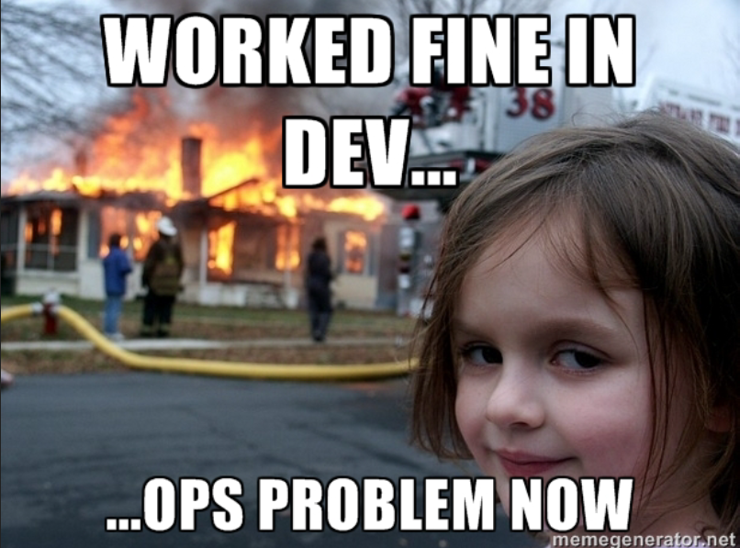

Slide 6

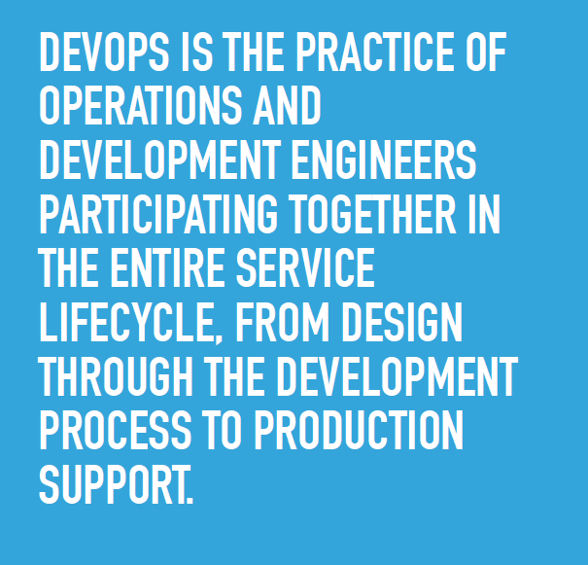

Slide 7
‣ High-performing IT organizations
deploy 30x more frequently with
200x shorter lead times; they have
60x fewer failures and recover from
issues 168x faster.
‣ Lean management and continuous
delivery practices create the
conditions for delivering value faster,
sustainably.
‣ High performance is achievable
whether your apps are greenfield,
brownfield or legacy.
‣ High-performing IT organizations
deploy 30x more frequently with
200x shorter lead times; they have
60x fewer failures and recover from
issues 168x faster.
‣ Lean management and continuous
delivery practices create the
conditions for delivering value faster,
sustainably.
‣ High performance is achievable
whether your apps are greenfield,
brownfield or legacy.

Slide 8
THE THREE PILLARS OF DEVOPS
Infrastructure Automation
Continuous Delivery
Reliability Engineering

Slide 9
INFRASTRUCTURE AUTOMATION TOOLING
Infrastructure Models - AWS Cloudformation, Terraform, Azure ARM
Templates, Ubuntu Juju
Hardware Provisioning - Packer, Foreman, MaaS, Cobbler, Crowbar
Digital Rebar
Configuration Management - Puppet, Chef, Ansible, Salt, CFEngine
Integration Testing - rspec, serverspec
Orchestration - Rundeck, Ansible, Kubernetes (for docker)

Slide 10
All You Need To Know about CICD
Integration (CI): Build and test
Deployment (CD): Deploy and integration test
Delivery: All the way to production.

Slide 11
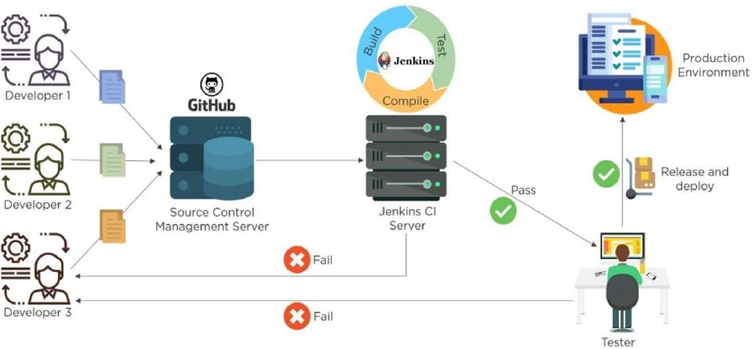
CI & CD

Slide 12
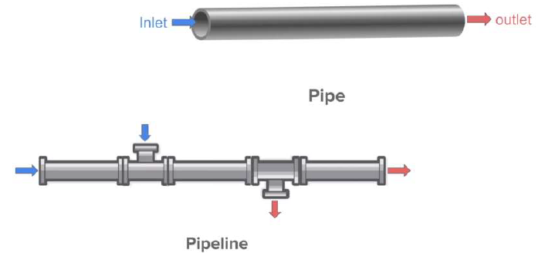
Jenkins Pipeline
In Jenkins, a pipeline is a group of events or jobs which are interlinked with one another in a sequence.

Slide 13
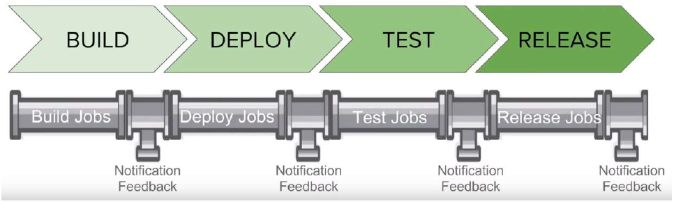

Slide 14
Thank you

